Slide 1

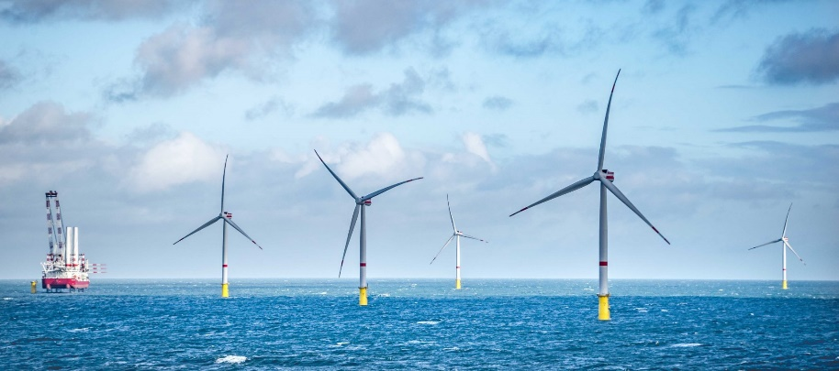
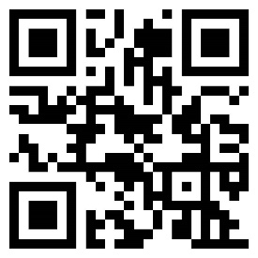
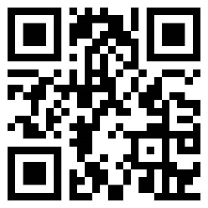
COP Graduate Program 2022
Accelerate your global career
Being a part of the COP Graduate program will give you the opportunity to develop personally and professionally. You will gain experience within the
fast-developing field of renewable energy, with an opportunity to impact the green transition and help set the path to a sustainable world.
Application Deadline:
March 25, until April 18, 2022
COP GP Website QR Code
COP Application Page

